Slide 1
Introduction To Electro-Pneumatic

Slide 2
Main pneumatic components
Pneumatic components can be divided into two categories: 1. Components that produce and transport compressed air. 2. Components that consume compressed air.

Slide 3
Main pneumatic components
The production and transportation of compressed air
Components that produce and transport compressed air include compressors and pressure regulating components.
a. Compressor A compressor compresses air to the required pressures.
It converts mechanical energy from motors and engines into pressure energy in compressed air
Compressors can be divided into two classes: reciprocatory and rotary

Slide 4
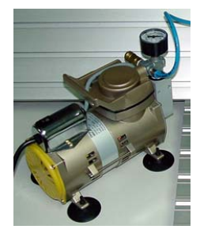
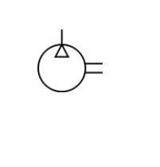

Slide 5
Main pneumatic components
1. The production and transportation of compressed air
b. Pressure regulating component Pressure regulating components are formed by various components, each of which has its own function and pneumatic symbol (i) Filter – can remove impurities from compressed air before it is fed to the pneumatic components. (ii) Pressure regulator – to stabilize the pressure and regulate the operation of pneumatic components (iii) Lubricator – To provide lubrication for pneumatic components

Slide 6
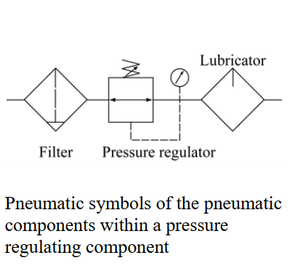
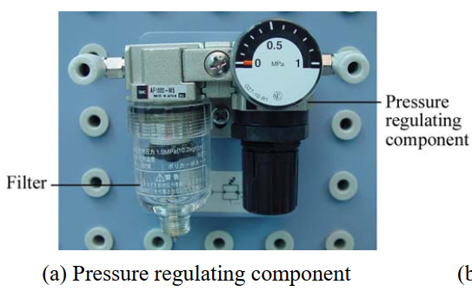

Slide 7
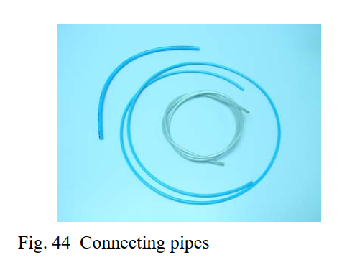
Main pneumatic components
1. The production and transportation of compressed air
c. Connecting pipe
Used to transport air within the circuit

Slide 8
Main pneumatic components
2. Components that consume compressed air.
Examples of components that consume compressed air include execution components (cylinders), directional control valves and assistant valves (a) Execution component Pneumatic execution components provide rectilinear or rotary movement. Examples of pneumatic execution components include cylinder pistons, pneumatic motors, etc.
Rectilinear motion is produced by cylinder pistons, while pneumatic motors provide continuous rotations. There are many kinds of cylinders, such as single acting cylinders, double acting cylinders and telescopic cylinders.

Slide 9
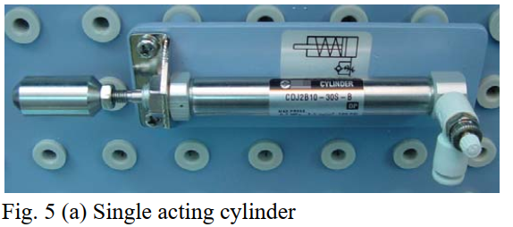
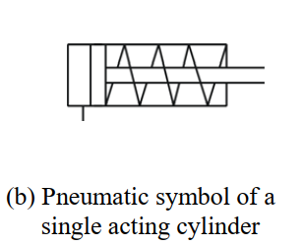
Main pneumatic components
(a) Execution component
Single acting cylinder
A single acting cylinder has only one entrance that allows compressed air to flow through. Therefore, it can only produce thrust in one direction.
The piston rod is propelled in the opposite direction by an internal spring, or by the external force provided by mechanical movement or weight of a load
The thrust from the piston rod is greatly lowered because it has to overcome the force from the spring.

Slide 10
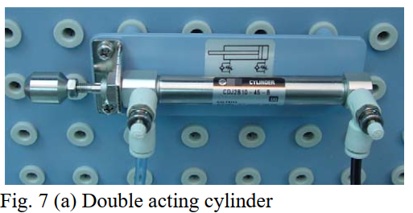
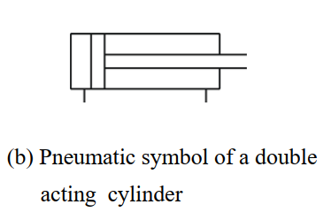
Main pneumatic components
(a) Execution component
(ii) Double acting cylinder
In a double acting cylinder, air pressure is applied alternately to the relative surface of the piston, producing a propelling force and a retracting force

Slide 11
Main pneumatic components
(a) Execution component
(ii) telescopic cylinder
Telescopic cylinders are used when an application requires a compact retracted dimension, but needs a longer stroke.
These cylinders are generally single acting and are available in two to five stages although there are double acting also.
It operates in stages, the fist part emerges from cylinder while other parts come from inside of previous part

Slide 12
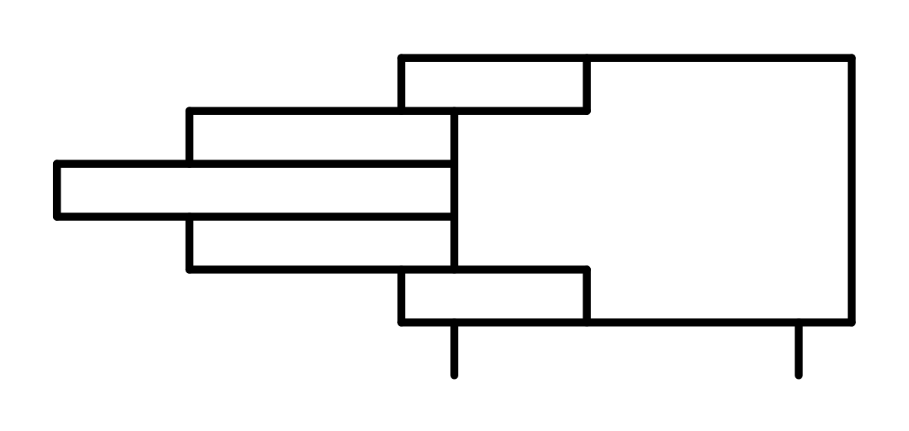
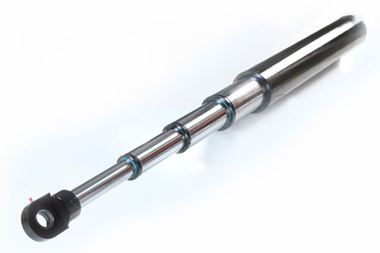
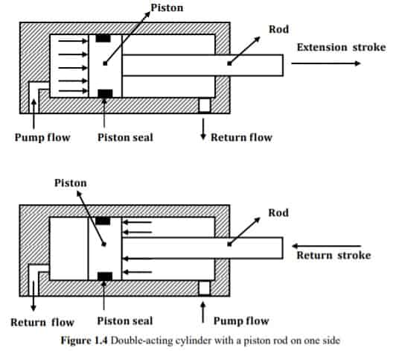
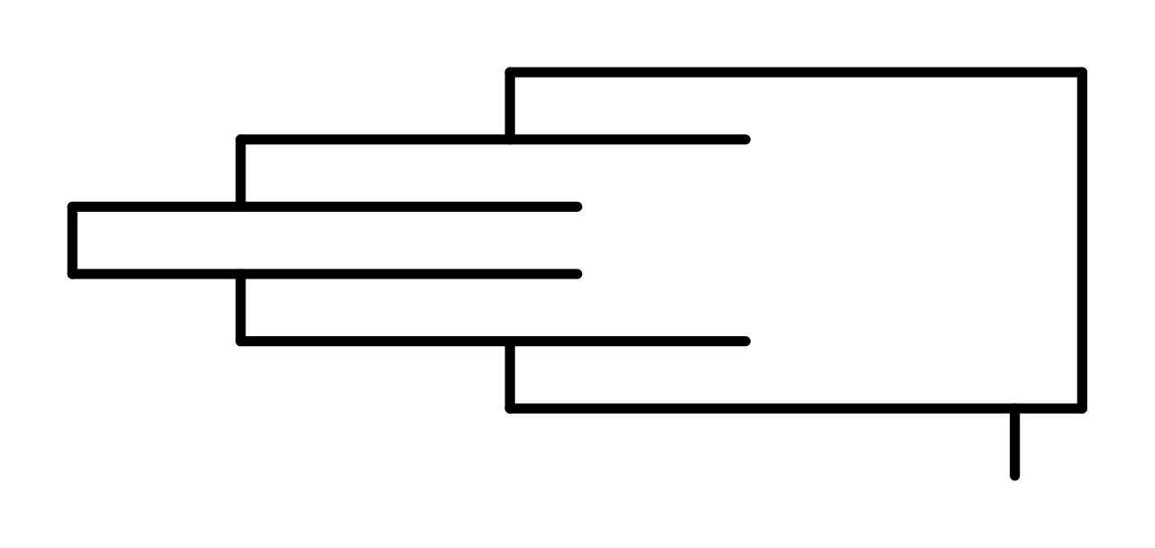

Slide 13
Main pneumatic components
(a) Execution component
Pneumatic Motor
A pneumatic motor (air motor), or compressed air engine, is a type of motor which does mechanical work by expanding compressed air.
Air motors are used to produce continuous rotary power from a compressed air system
A widespread application of pneumatic motors is in hand-held tools, impact wrenches, screwdrivers, nut runners, drills, grinders, sanders and so on.

Slide 14
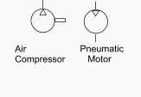
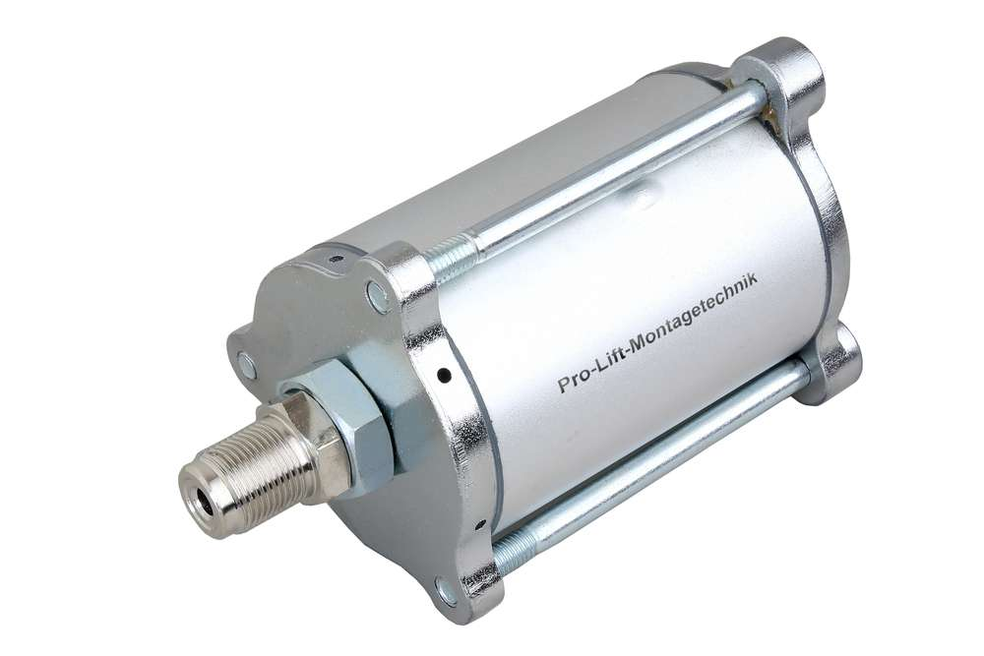
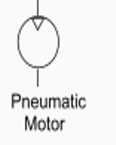

Slide 15
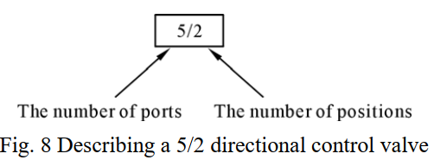
Main pneumatic components
2. Components that consume compressed air.
(b) Directional control valve Directional control valves ensure the flow of air between air ports by opening, closing and switching their internal connections Classification is determined by the number of ports, the number of switching positions, the normal position of the valve and its method of operation. Common types of directional control valves include 2/2, 3/2 and 5/2 The first number represents the number of ports; the second number represents the number of positions. A directional control valve that has five ports and two positions can be represented by

Slide 16
Main pneumatic components
2. Components that consume compressed air.
(b) Directional control valve
2/2 Directional control valve
The structure of a 2/2 directional control valve is very simple.
It uses the thrust from the spring to open and close the valve, stopping compressed air from flowing towards working tube ‘A’ from air inlet ‘P’.
When a force is applied to the control axis, the valve will be pushed open, connecting ‘P’ with ‘A’.
The force applied to the control axis has to overcome both air pressure and the repulsive force of the spring.
The control valve can be driven manually or mechanically, and restored to its original position by the spring

Slide 17
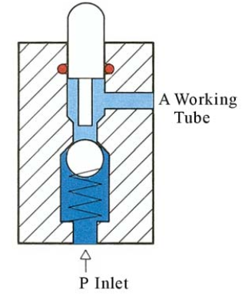
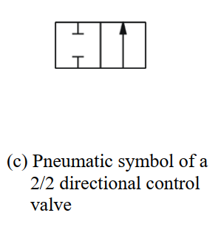

Slide 18
Main pneumatic components
2. Components that consume compressed air
(b) Directional control valve
(ii) 3/2 Directional control valve
A 3/2 directional control valve can be used to control a single acting cylinder.
The open valves in the middle will close until ‘P’ and ‘A’ are connected together.
Then another valve will open the sealed base between ‘A’ and ‘R’ (exhaust).
The valves can be driven manually, mechanically, electrically or pneumatically.
3/2 directional control valves can further be divided into two classes: Normally open type (N.O.) and normally closed type (N.C.)

Slide 19
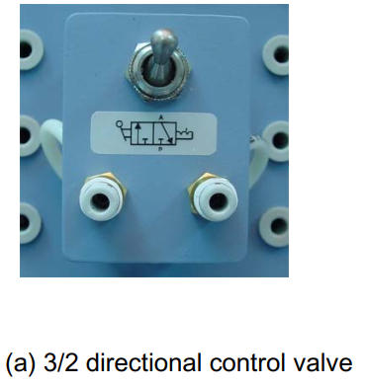
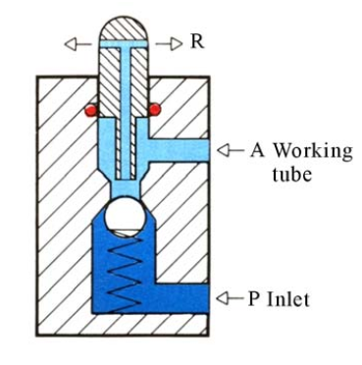
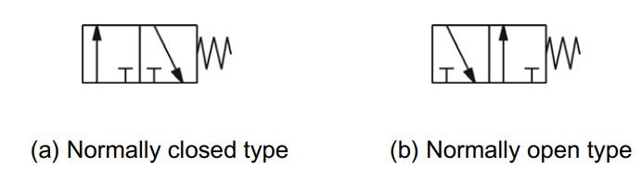

Slide 20
Main pneumatic components
2. Components that consume compressed air
(b) Directional control valve
(iii) 5/2 Directional control valve
When a pressure pulse is input into the pressure control port ‘P’, the spool will move to the left, connecting inlet ‘P’ and work passage ‘B’.
Work passage ‘A’ will then make a release of air through ‘R1’ and ‘R2’.
The directional valves will remain in this operational position until signals of the contrary are received.
Therefore, this type of directional control valves is said to have the function of ‘memory’.

Slide 21
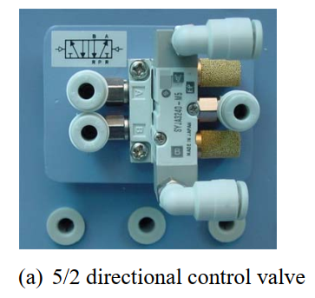
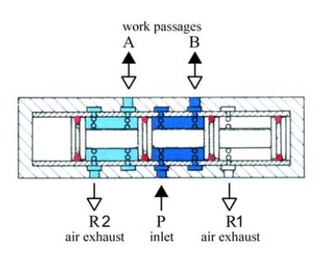
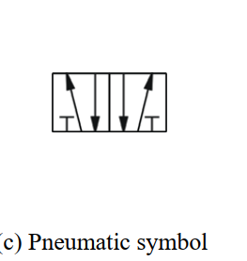

Slide 22
Main pneumatic components
2. Components that consume compressed air
(c) Control valve A control valve is a valve that controls the flow of air. Examples include non-return valves, flow control valves, shuttle valves (i) Non-return valve A non-return valve allows air to flow in one direction only.
When air flows in the opposite direction, the valve will close.
Another name for non-return valve is poppet valve

Slide 23
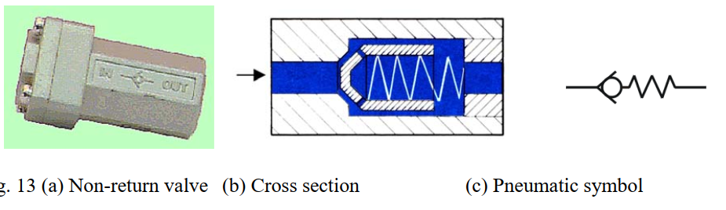
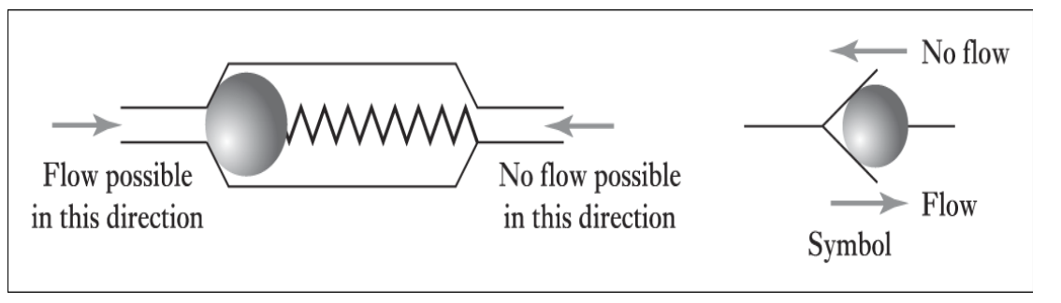

Slide 24
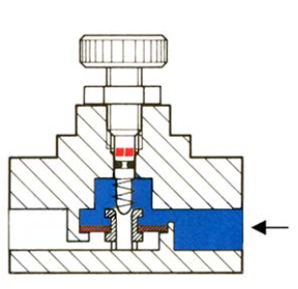
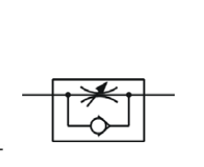
Main pneumatic components
2. Components that consume compressed air
(c) Control valve
(ii) Flow control valve A flow control valve is formed by a non-return valve and a variable throttle

Slide 25
Main pneumatic components
2. Components that consume compressed air
(c) Control valve
(iii) Shuttle valve
Shuttle valves are also known as double control or single control non-return valves.
A shuttle valve has two air inlets ‘P1’ and ‘P2’ and one air outlet ‘A’.
When compressed air enters through ‘P1’, the sphere will seal and block the other inlet ‘P2’. Air can then flow from ‘P1’ to ‘A’.
When the contrary happens, the sphere will block inlet ‘P1’, allowing air to flow from ‘P2’ to ‘A’ only.

Slide 26
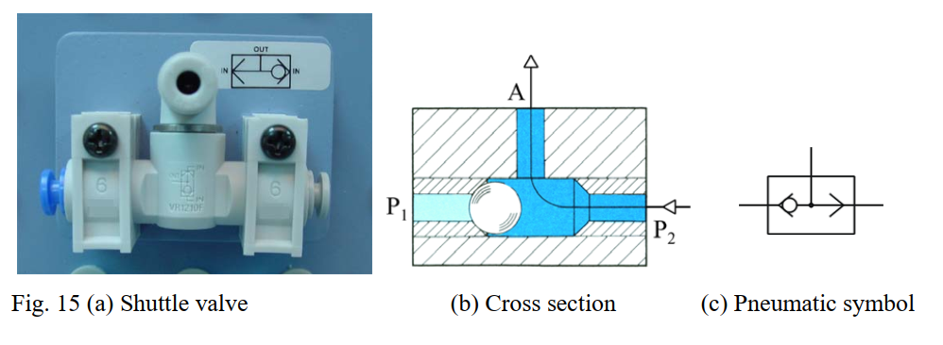

Slide 27
Main pneumatic components
2. Components that consume compressed air
(c) Control valve
(vi) Dual pressure valve
It requires two pressurized inputs to allow an output from itself.
This is achieved by one active input slides the shuttle valve shut blocking any air flow, add two active inputs and the shuttle remains centralized allowing flow through the valve.

Slide 28
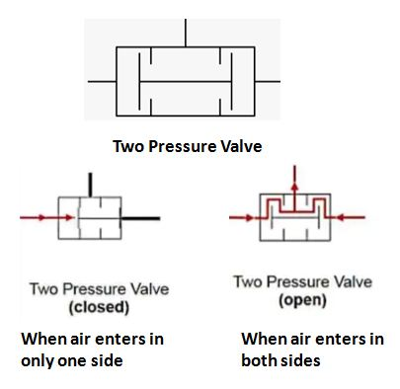
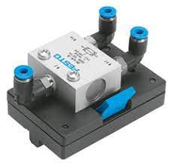
Main pneumatic components

Slide 29
Principles of Pneumatic Control
Pneumatic circuit
Pneumatic control systems can be designed in the form of pneumatic circuits.
A pneumatic circuit is formed by various pneumatic components, such as cylinders, directional control valves, flow control valves, etc.
Pneumatic circuits have the following functions:
To control the injection and release of compressed air in the cylinders/motors.
To use one valve to control another valve.
b) Pneumatic circuit diagram A pneumatic circuit diagram uses pneumatic symbols to describe its design.
Some basic rules must be followed when drawing pneumatic diagrams.

Slide 30
Principles of Pneumatic Control
b) Pneumatic circuit diagram
(I) Basic Rules
1. A pneumatic circuit diagram represents the circuit in static form and assumes there is no
supply of pressure. The placement of the pneumatic components on the circuit also follows this assumption
2. The pneumatic symbol of a directional control valve is formed by one or more squares.
The inlet and exhaust are drawn underneath the square, while the outlet is drawn on the top. Each function of the valve (the position of the valve) shall be represented by a square. If there are two or more functions, the squares should be arranged horizontally

Slide 31
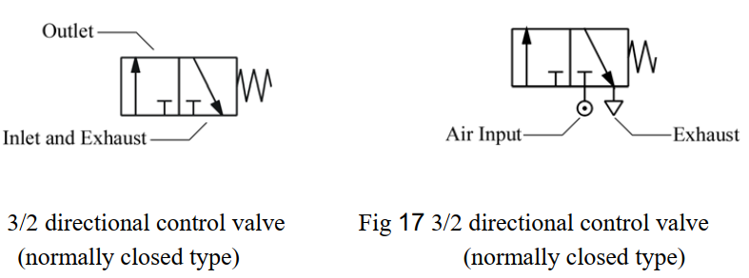

Slide 32
Principles of Pneumatic Control
b) Pneumatic circuit diagram
(I) Basic Rules
3. Arrows "↓↖" are used to indicate the flow direction of air current. If the external port is not connected to the internal parts, the symbol “┬” is used. The symbol “⊙” underneath the square represents the air input, while the symbol “▽” represents the exhaust.
4. The pneumatic symbols of operational components should be drawn on the outside of the squares.
They can be mechanically, manually, pneumatically or electrically operated

Slide 33
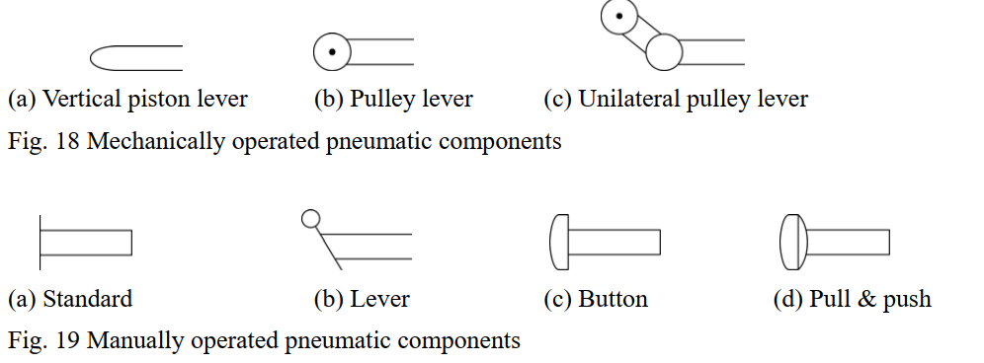

Slide 34
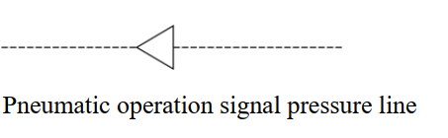
Principles of Pneumatic Control
b) Pneumatic circuit diagram
(I) Basic Rules
5. Pneumatic operation signal pressure lines should be drawn on one side of the squares, while triangles are used to represent the direction of air flow

Slide 35
Principles of Pneumatic Control
b) Pneumatic circuit diagram
(II) Basic Principles
Fig. below shows some of the basic principles of drawing pneumatic circuit diagrams, the numbers in the diagram correspond to the following points:
1. When the manual switch is not operated, the spring will restore the valve to its original position. 2. From the position of the spring, one can deduce that the block is operating. The other block will not operate until the switch is pushed. 3. Air pressure exists along this line because it is connected to the source of compressed air. 4. As this cylinder cavity and piston rod are under the influence of pressure, the piston rod is in its restored position. 5. The rear cylinder cavity and this line are connected to the exhaust, where air is released

Slide 36
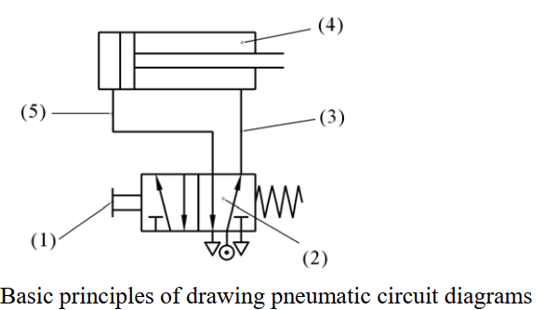

Slide 37
Principles of Pneumatic Control
b) Pneumatic circuit diagram
(iii) The setting of circuit diagrams
When drawing a complete circuit diagram, one should place the pneumatic components on different levels and positions, so the relations between the components can be expressed clearly. This is called the setting of circuit diagrams.
A circuit diagram is usually divided into three levels:
Power level
Logic level and
Signal input level

Slide 38
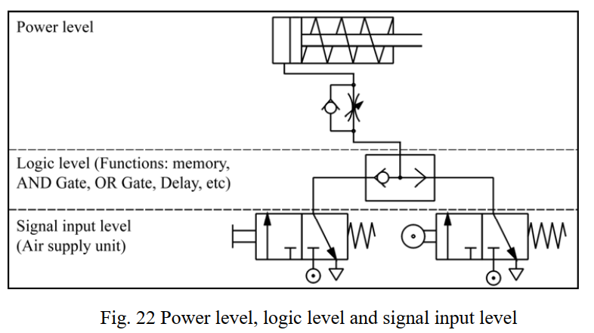
Principles of Pneumatic Control b) Pneumatic circuit diagram (iii) The setting of circuit diagrams

Slide 39
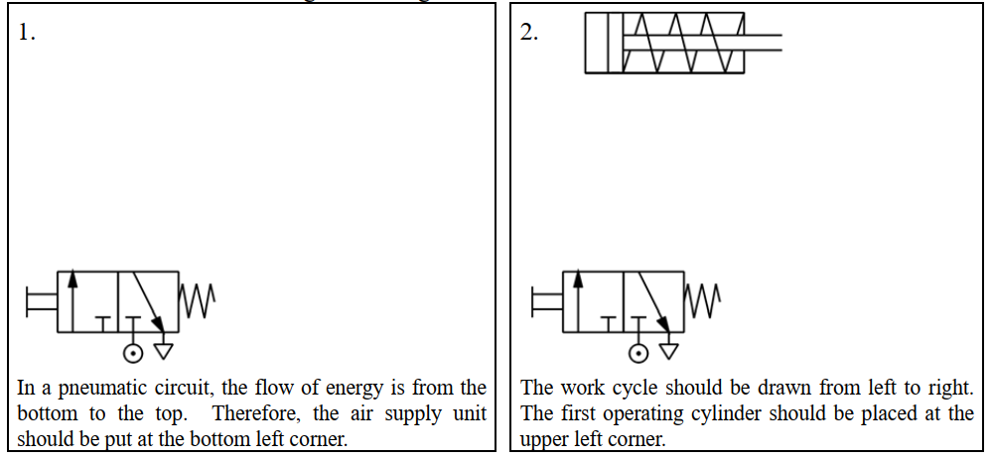
Principles of Pneumatic Control b) Pneumatic circuit diagram (iii) The setting of circuit diagrams

Slide 40
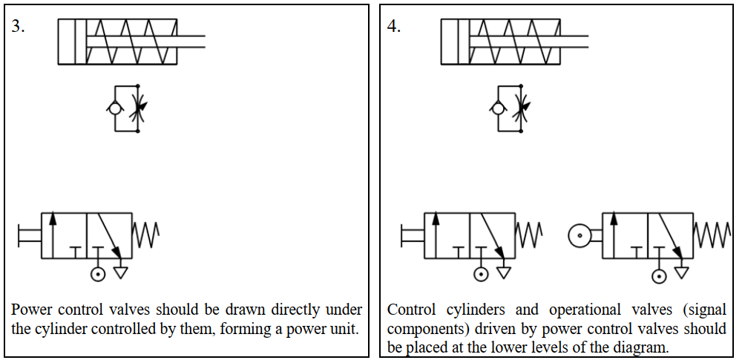
Principles of Pneumatic Control b) Pneumatic circuit diagram (iii) The setting of circuit diagrams

Slide 41
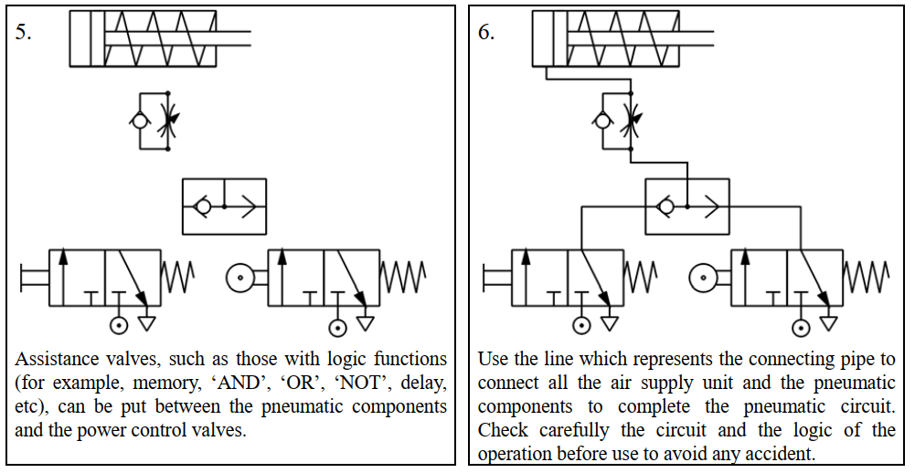
Principles of Pneumatic Control b) Pneumatic circuit diagram (iii) The setting of circuit diagrams

Slide 42
Different Kinds of Basic Circuits
A basic circuit is a pneumatic circuit designed to perform basic tasks, such as
Flow amplification
Signal inversion
Memory
Delay
Single acting cylinder control
Double acting cylinder control

Slide 43
Different Kinds of Basic Circuits
Flow amplification
Cylinders with a large capacity require a larger flow of air, which can be hazardous to users.
It is unsafe to manually operate pneumatic directional control valves with large flow capacity.
Instead we should first operate manually a small control valve and use it to operate the pneumatic control system with large flow capacity.
This is called flow amplification, which can greatly ensure the safety of the operators.
During operation, valves with large flow capacity should be placed near the cylinder, while valves with smaller flow capacity should be placed on control boards some distances away.
Fig. below shows a basic flow amplification circuit.
Notice how different components are placed on different levels.

Slide 44
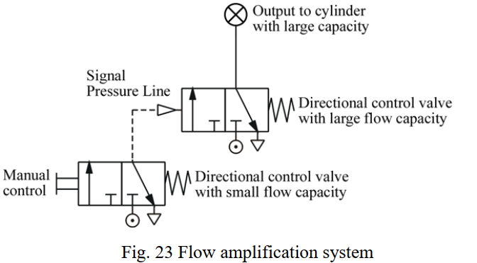

Slide 45
Different Kinds of Basic Circuits
(b) Signal inversion The pneumatic diagram in Fig. below shows how directional control valves can be switched. When operating control valve ①, control valve ② will stop producing pressure output.
When control valve ① ceases operation and is restored to its original position, control valve ② will resume its output.
Therefore, at any given time, the pressure output of control valve ① is the exact opposite of that of control valve ②

Slide 46
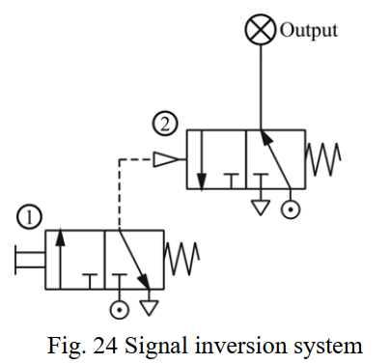

Slide 47
Different Kinds of Basic Circuits
(c) Memory Function Memory function can keep a component at a certain state permanently until there is a change of signals. Fig. below shows a memory function circuit.
When control valve ① is operated momentarily (that is, pressed for a short time), the output signal of the 5/2 directional control valve ③ will be set to ON.
The signal will stay that way until control valve ② is operated momentarily and generates another signal to replace it, causing it to stay permanently at OFF.

Slide 48
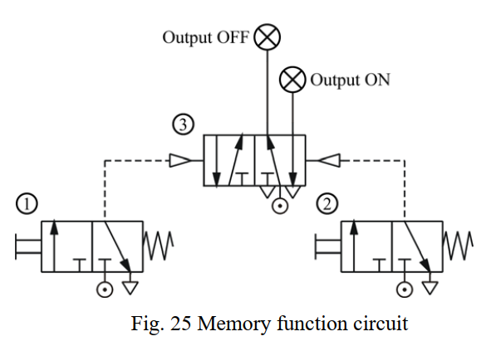

Slide 49
Different Kinds of Basic Circuits
(d) Delay function A pneumatic delay circuit can delay the operating time of the next control valve.
Its principle of operation involves the use of an orifice to slow down the flow of air and control the time of pneumatic operation.
Delay functions can be divided into two classes: ON-signal delay and OFF signal delay.

Slide 50
Different Kinds of Basic Circuits
(d) Delay function
ON-signal delay
Fig. below shows the circuit diagram of an ON-signal delay circuit, which delays the output of the next control valve.
When control valve ① is operated, the one way flow control valve will slow down the flow of air, thus delaying the signal output of the outlet of control valve ② (A), resulting in a persistent ON-signal.
The time when control valve ② will be restored to its original position is not affected.

Slide 51
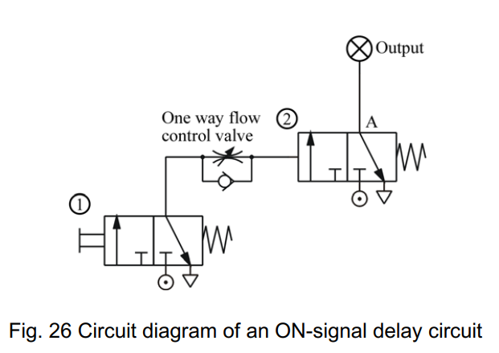

Slide 52
Different Kinds of Basic Circuits
(d) Delay function
(ii) OFF-signal Delay Fig. below shows the circuit diagram of an OFF-signal delay circuit, which delays the output of the next control valve.
This circuit is similar to an ON-signal delay circuit.
The only difference is that the one way flow control valve is connected in the opposite direction.
Therefore, when control valve ① is operated, the outlet of control valve ② (A) will continue to output signals.
However, when control valve ② is restored to its original position, the release of air is slowed down by the one way flow control valve, resulting in a persistent OFF-signal.

Slide 53
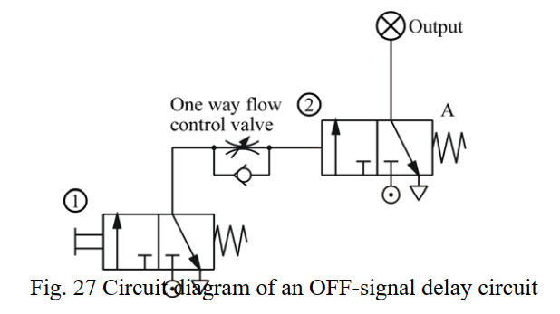

Slide 54
Different Kinds of Basic Circuits
(e) Single acting cylinder control Single acting cylinders can be controlled manually.
However, they can also be controlled by two or more valves. This is called logic control.
Examples of logic control include ‘OR’ function, ‘AND’ function, ‘NOT’ function, etc.

Slide 55
Different Kinds of Basic Circuits
(e) Single acting cylinder control (i) Direct control and speed control If a single acting cylinder is connected to a manual 3/2 directional control valve, when the control valve is operated, it will cause the cylinder to work Therefore, the circuit allows the cylinder to be controlled manually.
The only way to change the extension speed of the piston of a single acting cylinder is to restrict the flow of air at the inlet and use the spring to determine the speed of retraction.
Therefore, a one way flow control valve is placed in the circuit to control the speed.

Slide 56
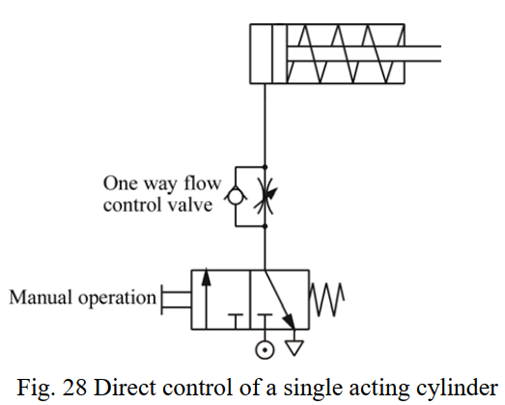

Slide 57
Different Kinds of Basic Circuits
(e) Single acting cylinder control (ii) OR Function The single acting cylinder in Fig. below can be operated by two different circuits.
Examples include manual operation and relying on automatic circuit signals, that is, when either control valve ① or control valve ② is operated, the cylinder will work.
Therefore, the circuit in Fig. below possesses the OR function.
However, if the output of two 3/2 directional control valves are connected through the port of a triode, the air current from control valve ① will be released through the exhaust of control valve ②, and so the cylinder will not work.
This problem can be solved by connecting a shuttle valve to the port of the triode.

Slide 58
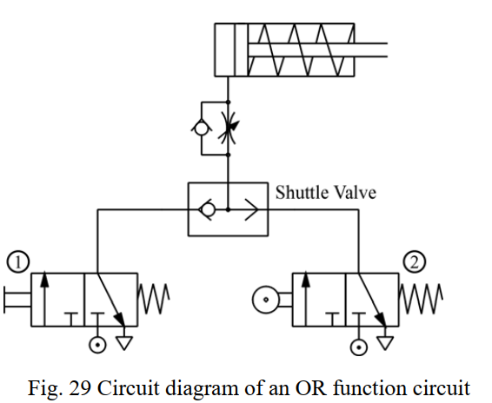

Slide 59
Different Kinds of Basic Circuits
(e) Single acting cylinder control (iii) AND Function Another name for an AND function is interlock control.
This means control is possible only when two conditions are satisfied.
A classic example is a pneumatic system that works only when its safety door is closed and its manual control valve is operated.
The flow passage will open only when both control valves are operated. Fig. below shows the circuit diagram of an AND function circuit.
The cylinder will work only when both valve ① and ② are operated.

Slide 60
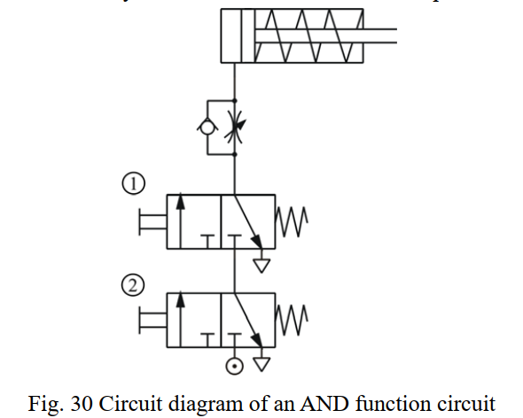

Slide 61
Different Kinds of Basic Circuits
(e) Single acting cylinder control
(iv) NOT Function Another name for a NOT function is inverse control.
In order to hold or lock an operating conveyor or a similar machine, the cylinder must be locked until a signal for cancelling the lock is received.
Therefore, the signal for cancelling the lock should be operated by a normally open type control valve.
However, to cancel the lock, the same signal must also cancel the locks on other devices, like the indication signal ③ in Fig. below.
Fig. below shows how the normally closed type control valve ① can be used to cut off the normally open type control valve ② and achieve the goal of changing the signal

Slide 62
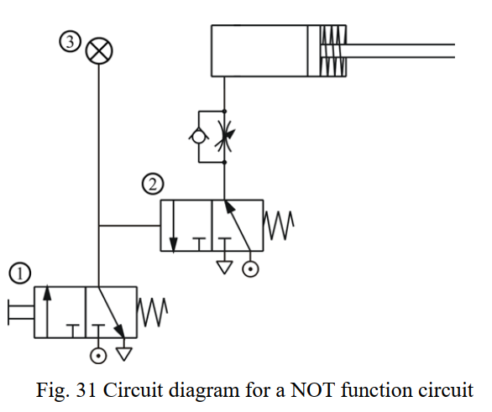

Slide 63
Different Kinds of Basic Circuits
(f) Double acting cylinder (i) Direct control The only difference between a single acting cylinder and a double acting cylinder is that a double acting cylinder uses a 5/2 directional control valve instead of a 3/2 directional control valve Usually, when a double acting cylinder is not operated, outlet ‘B’ and inlet ‘P’ will be connected.
In this circuit, whenever the operation button is pushed manually, the double acting cylinder will move back and forth once.

Slide 64
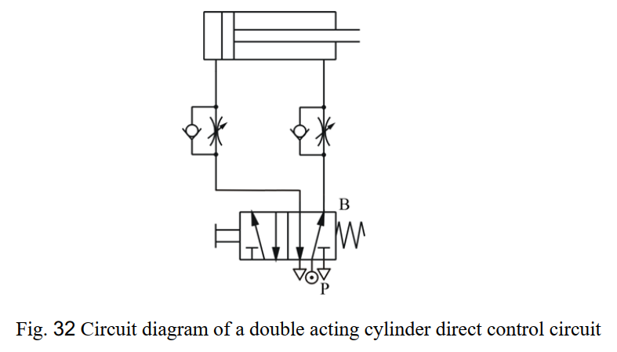

Slide 65
Different Kinds of Basic Circuits
(f) Double acting cylinder (i) Direct control cont…
In order to control the speed in both directions, flow control valves are connected to the inlets on both sides of the cylinder.
The direction of the flow control valve is opposite to that of the release of air by the flow control valve of the single acting cylinder.
Compared to the throttle inlet, the flow control valve is tougher and more stable. Connecting the circuit in this way allows the input of sufficient air pressure and energy to drive the piston

Slide 66
Different Kinds of Basic Circuits
(f) Double acting cylinder
(ii) Single control A cylinder always has to maintain its position in a lot of situations, even after the operational signal has disappeared.
This can be achieved by the use of a circuit that possesses the memory function.
As shown in Fig. below, the extension path of a double acting cylinder is activated by control valve ①, while retraction is governed by control valve ②.
Control valve ③, on the other hand, maintains the position of the cylinder by maintaining its own position. Control valve ③ will be changed only when one of the manual control valves is pushed.
If both control valves ① and ② are operated at the same time, control valve ③ will be subject to the same pressure and will remain in its original position.

Slide 67


Slide 68
Cylinder Troubleshooting
Pneumatic cylinder failure typically results from different conditions:
Side-load mounting
Contamination
Lack of lubrication and
Operation in excess of component limits

